Slide 1
Graph Data Structures, Graph Transversal Algorithms And Its Implementation In Real Life

Slide 2
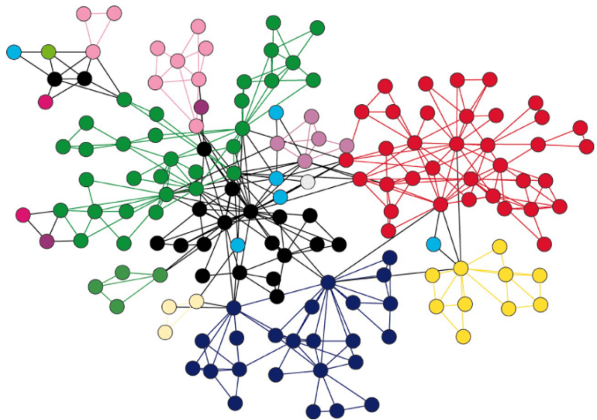
What is a Graph?
A graph is a unique data structure in programming that consists of finite sets of nodes or vertices and a set of edges that connect these vertices to them. At this moment, adjacent vertices can be called those vertices that are connected to the same edge with each other. In simple terms, a graph is a visual representation of vertices and edges sharing some connection or relationship

Slide 3
Types of Graphs
There are various types of graph algorithms that you would be looking at in this article but before that, let's look at some types of terms to imply the fundamental variations between them.
Order: Order defines the total number of vertices present in the graph.
Size: Size defines the number of edges present in the graph.
Self-loop: It is the edges that are connected from a vertex to itself.
Isolated vertex: It is the vertex that is not connected to any other vertices in the graph.
Vertex degree: It is defined as the number of edges incident to a vertex in a graph.
Weighted graph: A graph having value or weight of vertices.
Unweighted graph: A graph having no value or weight of vertices.
Directed graph: A graph having a direction indicator.
Undirected graph: A graph where no directions are defined.

Slide 4
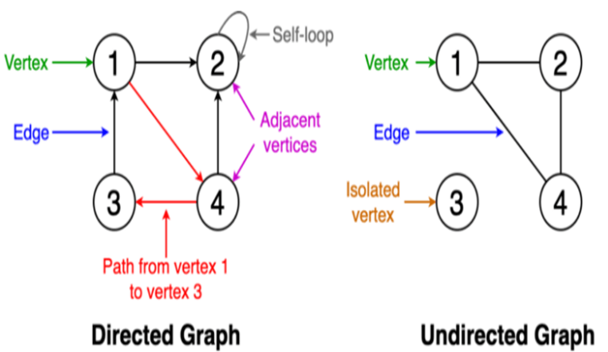

Slide 5
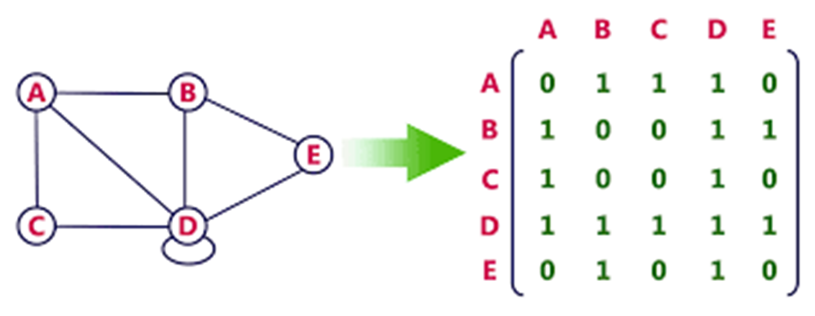
GRAPH IMPLEMENTATIONS
Adjacency Matrix: An adjacency matrix is a two-dimensional array that records the relationship between each node and all other nodes in the graph.

Slide 6
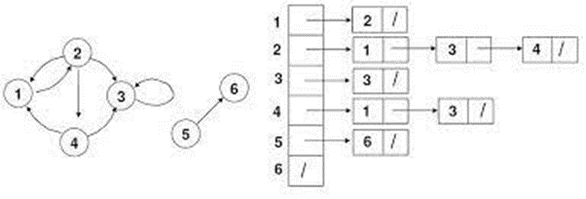
2. Adjacency List; An adjacency list records the existence of an edge between each node and all of its neighbours
Adjacency list for Directed graph;

Slide 7
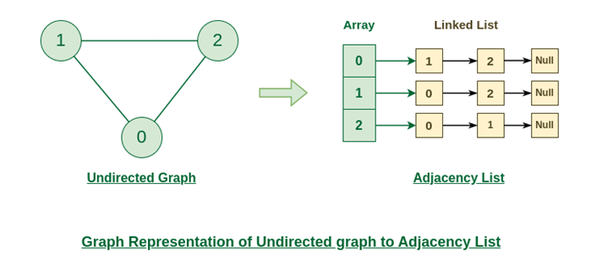
Adjacency list for Directed graph;

Slide 8
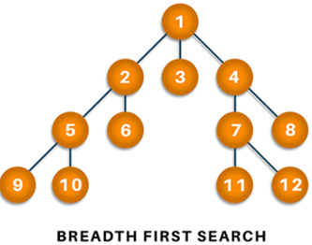
Graph Transversal Algorithm;
Breadth-First Search (BFS);
Traversing or searching is one of the most used operations that are undertaken while working on graphs. Therefore, in breadth-first-search (BFS), you start at a particular vertex, and the algorithm tries to visit all the neighbors at the given depth before moving on to the next level of traversal of vertices

Slide 9
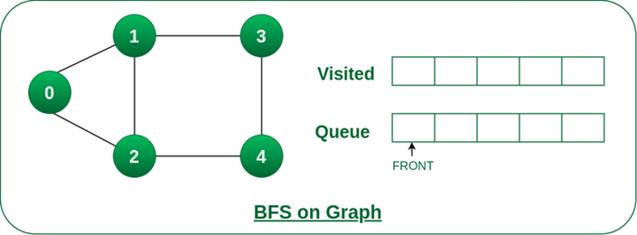
How It Works; Step1: Initially queue and visited arrays are empty

Slide 10
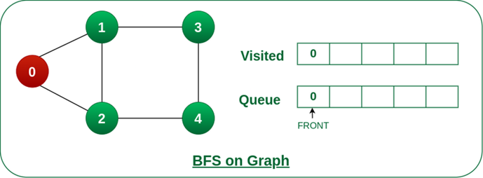
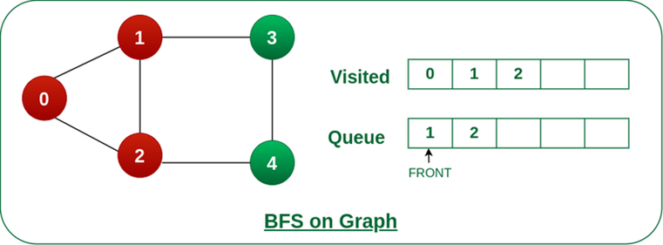
Step2: Push node 0 into queue and mark it visited.
Step 3: Remove node 0 from the front of queue and visit the unvisited neighbours and push them into queue.

Slide 11
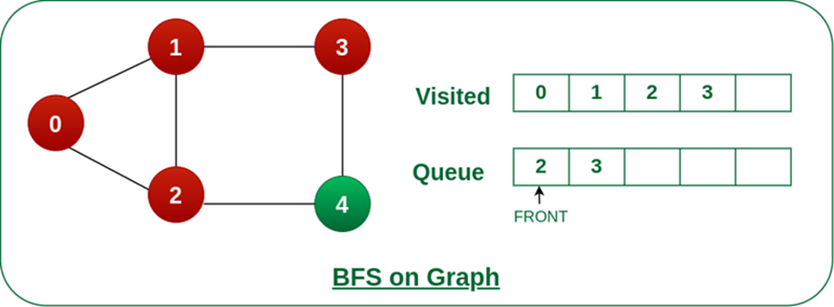
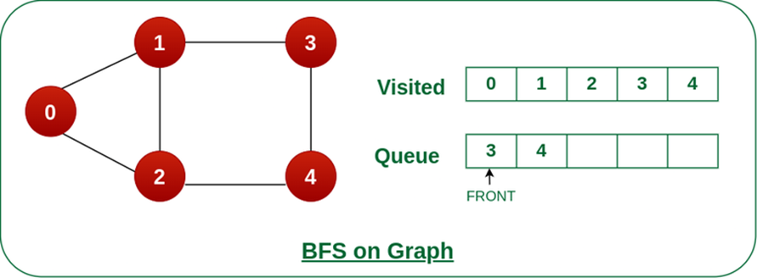
Step 4: Remove node 1 from the front of queue and visit the unvisited neighbours and push them into queue.
Step 5: Remove node 2 from the front of queue and visit the unvisited neighbours and push them into queue.

Slide 12

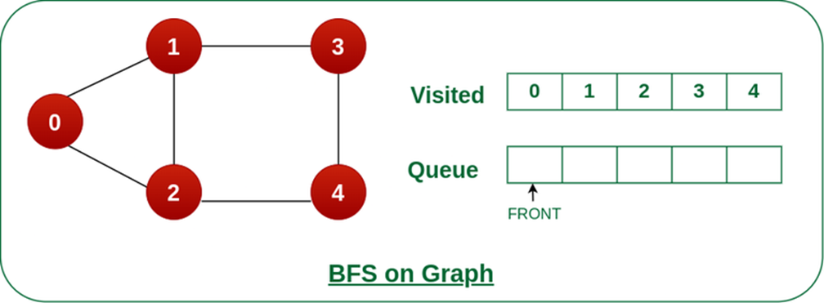
Step 6: Remove node 3 from the front of queue and visit the unvisited neighbours and push them into queue. As we can see that every neighbours of node 3 is visited, so move to the next node that are in the front of the queue.
Steps 7: Remove node 4 from the front of queue and visit the unvisited neighbours and push them into queue. As we can see that every neighbours of node 4 are visited, so move to the next node that is in the front of the queue.
Now, Queue becomes empty, So, terminate these process of iteration

Slide 13
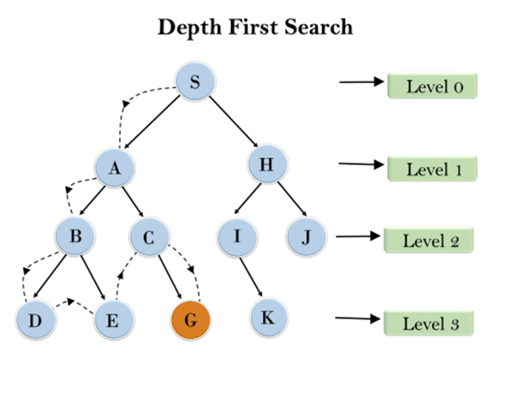
Depth-first search;
In depth-first-search (DFS), you start by particularly from the vertex and explore as much as you along all the branches before backtracking. In DFS, it is essential to keep note of the tracks of visited nodes, and for this, you use stack data structure.

Slide 14
Application of Graphs in real life problems
1. Social Networks: DFS and BFS can be used to find connections between individuals in a social network, recommend friends, or identify communities within the network.
2. Web Crawling: Search engines use BFS to crawl and index web pages, ensuring that all pages are visited and indexed in an organized manner.
3. Routing and Navigation: These algorithms are used to find the shortest path between locations in GPS systems and map applications.
4. Network Analysis: BFS and DFS are used to analyze computer networks, detect vulnerabilities, and optimize network traffic.
5. Game Development: Graph traversal algorithms are used to find paths, analyze game maps, and make decisions for non-player characters (NPCs) in video games.

